Slide 1
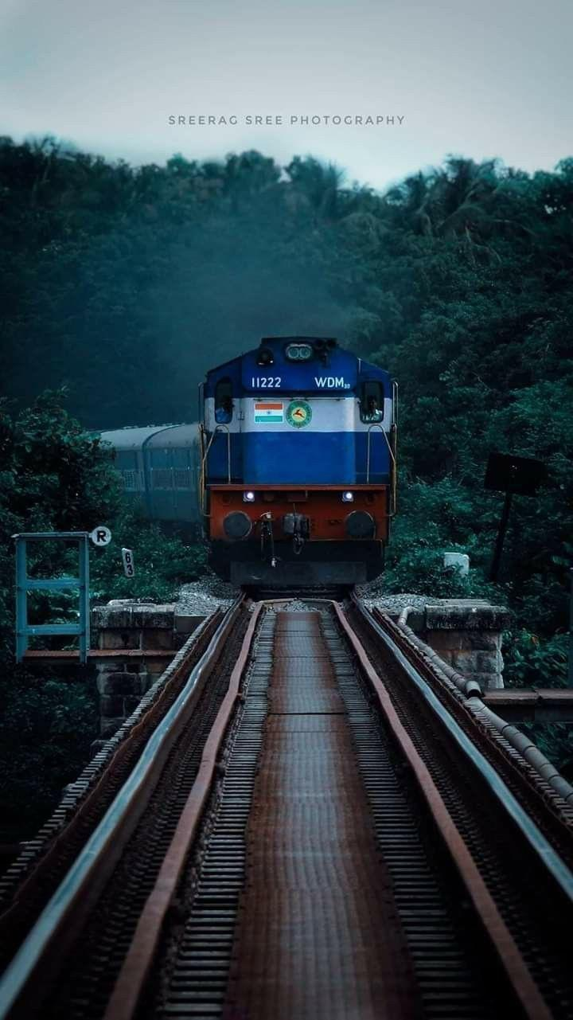

INDIAN
RAILWAY
NAVIGATOR
Under the Guidance of Dr.Dootika vats
Presented by: Group 14
INDIAN RAILWAY

Slide 2
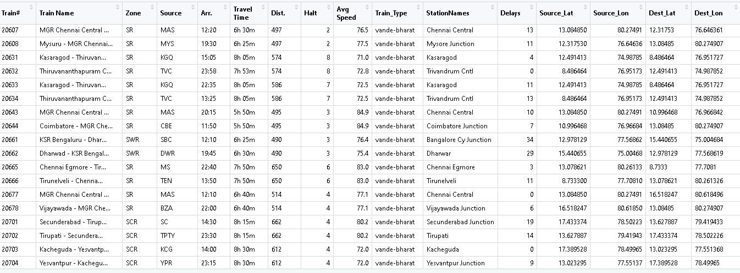
ABOUT DATA :
Our data contains various information about Indian trains like about their zone, number of halts, average delay, geographical location of stations, type of train etc.

Slide 3
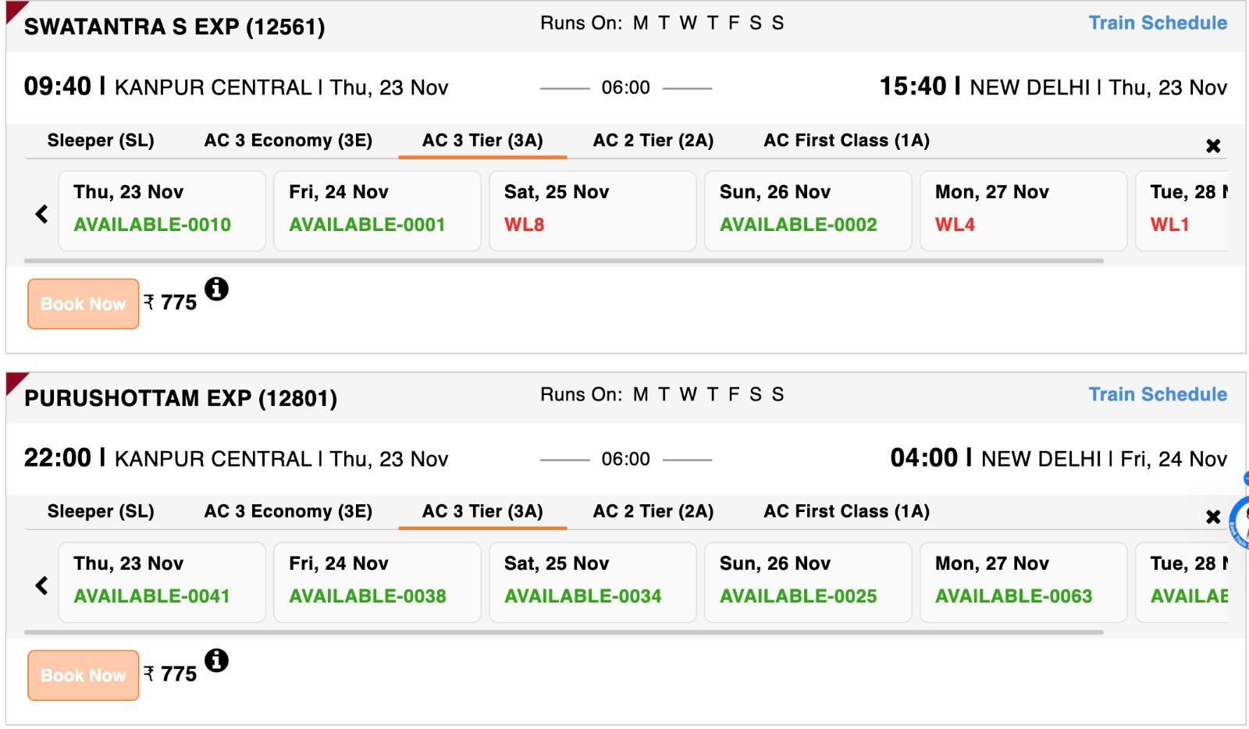
WHICH TRAIN SHOULD I CHOOSE ?

Slide 4
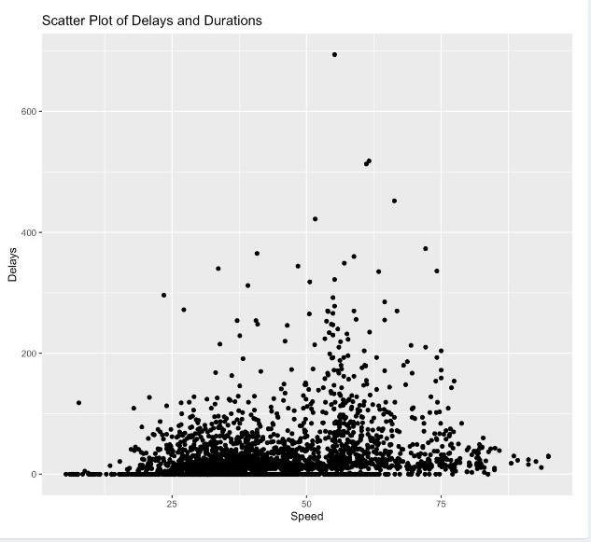
VISUALISATIONS :
As we can see there is no clear relationship between delays and average speed of trains.
The correlation between delays and average speed is 0.27.

Slide 5
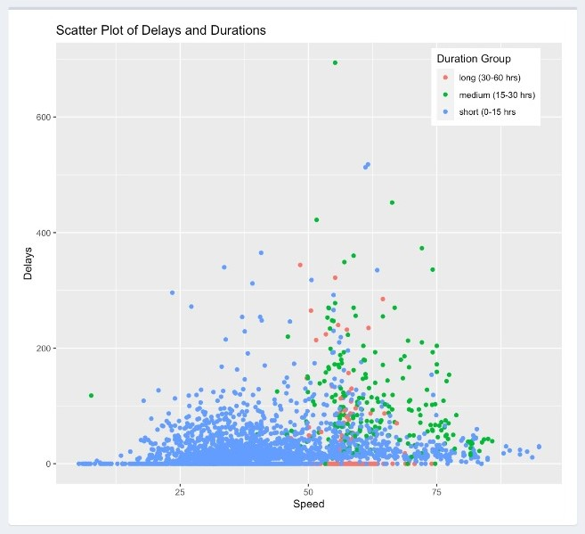
On dividing the plot into different areas by highlighting various duration groups, we see some discernible pattern.
The number of short duration trains is significantly more than medium and long duration trains. However, the range of delays is still limited.
However, even within different subgroups, there is no clear relation between average speed and train delays.

Slide 6
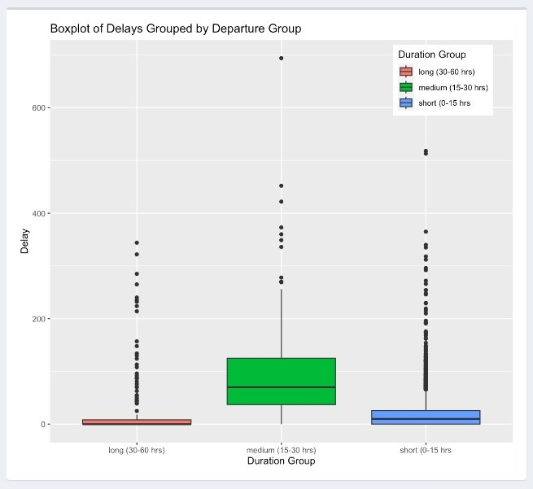
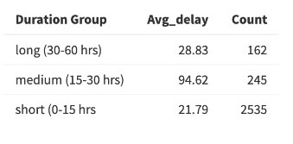
The boxplot of different duration groups with respect to delays shows the same pattern as the scatter plot.
The spread for medium duration trains is the most which is clearly visible in both the graphs. Also, the number of outliers is more in medium duration trains.

Slide 7
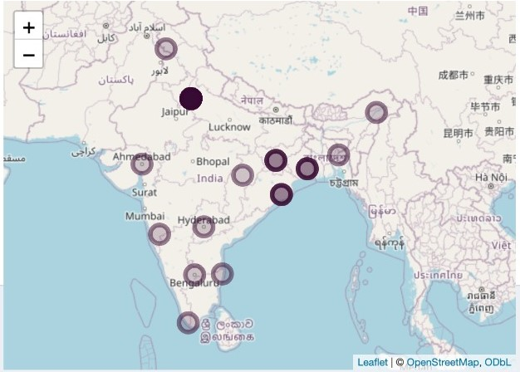
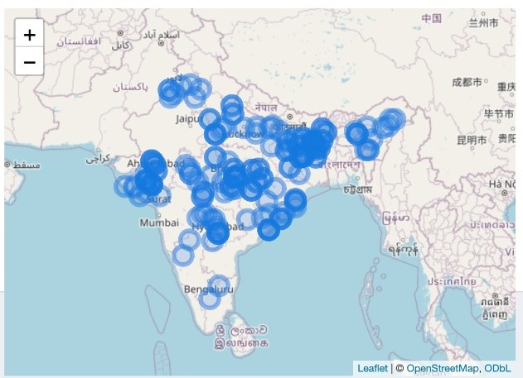
Rajadhani
Passenger
Rajadhani express a prominent train services in india as the name suggest it believe to be cover all the states of India but as our map suggest either it cover them unequally or does not provide service to those states.
Passenger train services in india is very dense and well distributed which helps rural population of India to travel better.

Slide 8
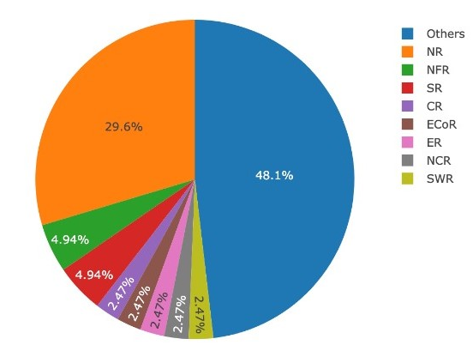
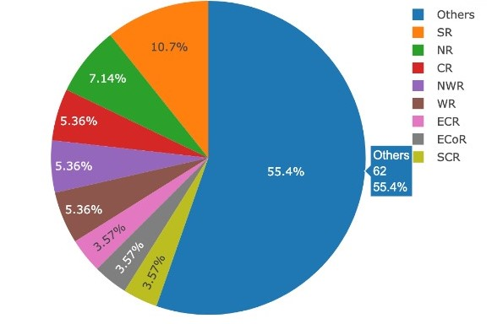
Shatabdi
Vande Bharat
Upon analysing pie charts of various trains it is clearly evident that Northern Railways comprises as most dense zone of Indian Railways.
And we can also see New trains services like Vande Bharat are evenly distributed across whole India.

Slide 9
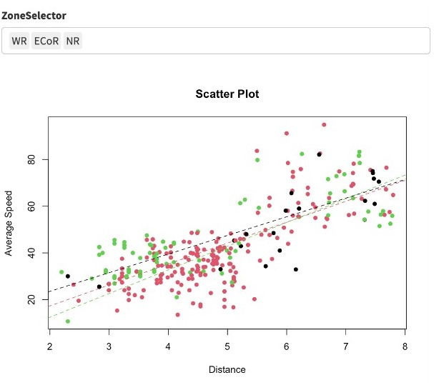
From this plot we can clearly see there is a positive correlation between Distance of the journey and Average speed of the train.

Slide 10
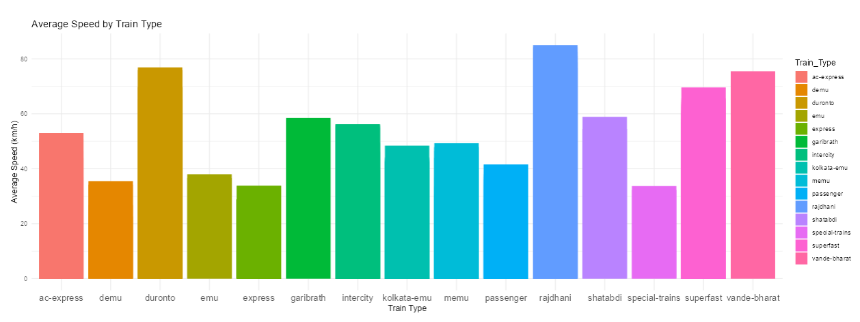
The graph indicates Rajdhani Express as the fastest at 90 km/h, followed by Vande Bharat Express. MEMU, EMU, and DEMU trains are the slowest. Within each type, there's a wide speed range due to factors like distance, stops.

Slide 11
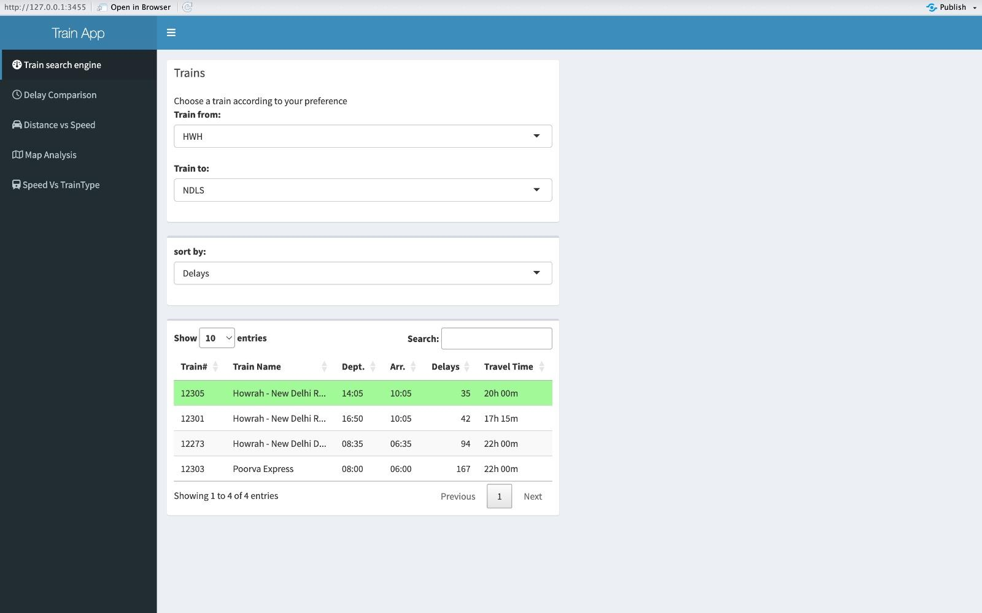
R SHINY APP :

Slide 12
THANK YOU !

